Slide 1

Software Design (swD392)
Ch02 – Overview of THE uml notation

Slide 2
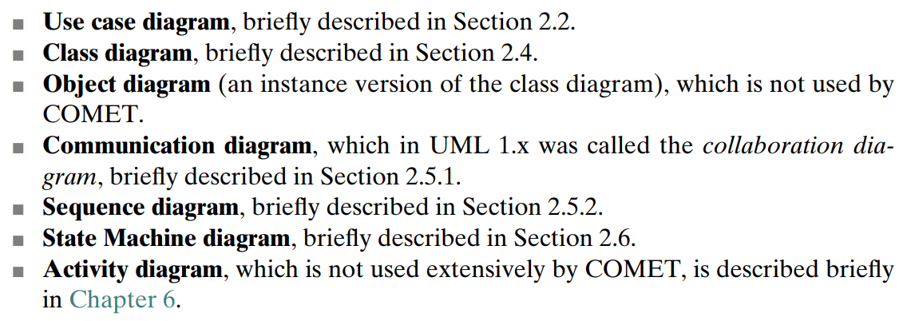
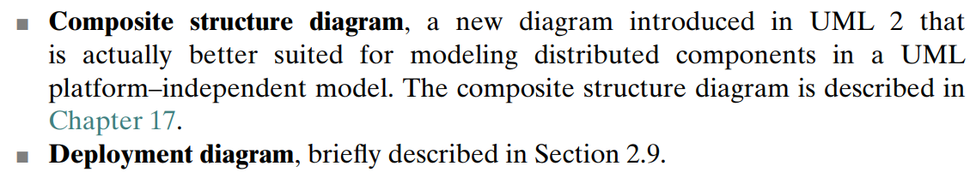
UML Diagrams
Notes:
https://www.igi-global.com/dictionary/omg/20835

Slide 3
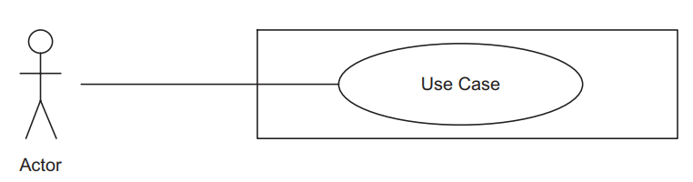
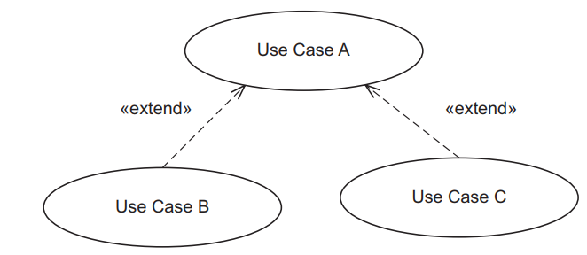
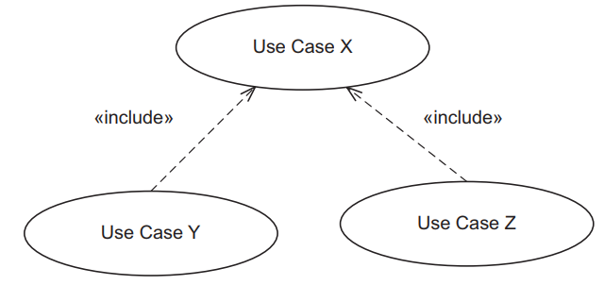
Use Case Diagrams
An actor initiates a use case.
A use case defines a sequence of interactions between the actor and the system.

Slide 4
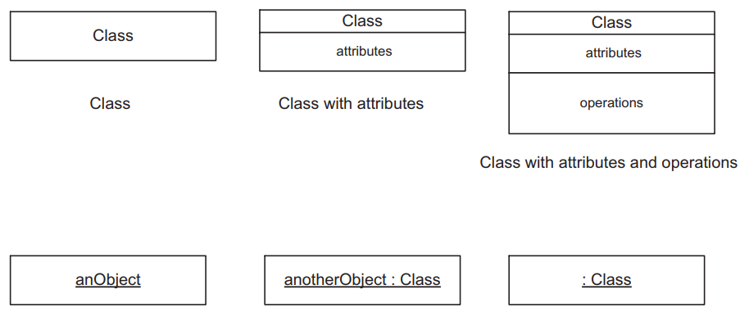
Classes & Objects
To distinguish between a class (the type) and an object (an instance of the type), an object name is shown underlined.
An object can be depicted in full with the object name separated by a colon from the class name

Slide 5
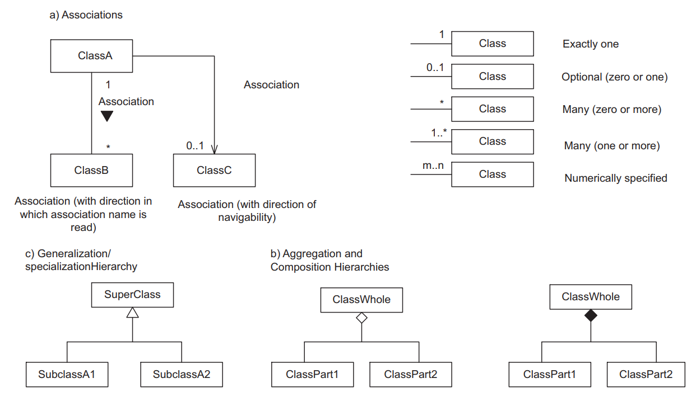
Class Diagrams Relationship Hierarchies
An association is a static, structural relationship between two or more classes. The multiplicity of an association specifies how many instances of one class may relate to a single instance of another class A generalization/specialization hierarchy is an inheritance relationship Aggregation and composition hierarchies are whole/part relationships

Slide 6
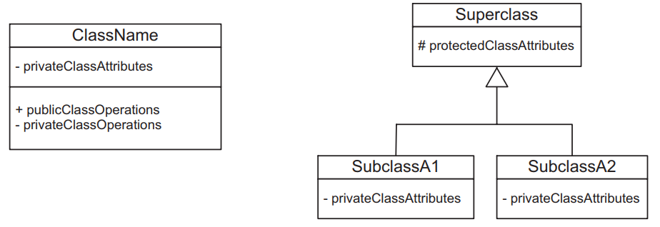
Class Diagrams Visibility
Public visibility, denoted with a + symbol, means that the element is visible from outside the class.
Private visibility, denoted with a – symbol, means that the element is visible only from within the class that defines it and is thus hidden from other classes.
Protected visibility, denoted with a # symbol, means that the element is visible from within the class that defines it and within all subclasses of the class.

Slide 7
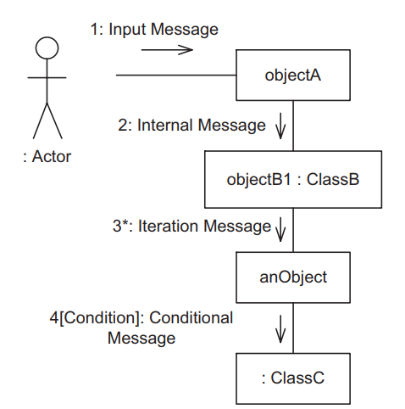
Interaction Diagrams Communication Diagram
UML has two main kinds of interaction diagrams, which depict how objects interact: the communication diagram and the sequence diagram
Communication Diagram
Notes:
A communication diagram, which was called a collaboration diagram in UML 1.x, shows how cooperating objects dynamically interact with each other by sending and receiving messages. The diagram depicts the structural organization of the objects that interact. Objects are shown as boxes, and lines joining boxes represent object interconnection. Labeled arrows adjacent to the arcs indicate the name and direction of message transmission between objects. The sequence of messages passed between the objects is numbered. An optional iteration is indicated by an asterisk (∗), which means that a message is sent more than once. An optional condition means that the message is sent only if the condition is true.

Slide 8
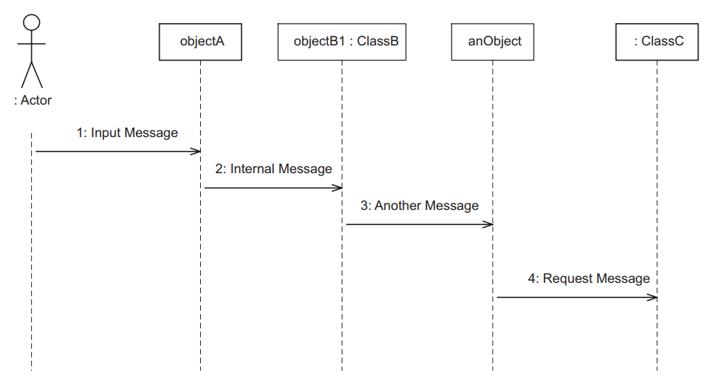
Interaction Diagrams Sequence Diagram
Sequence Diagram

Slide 9
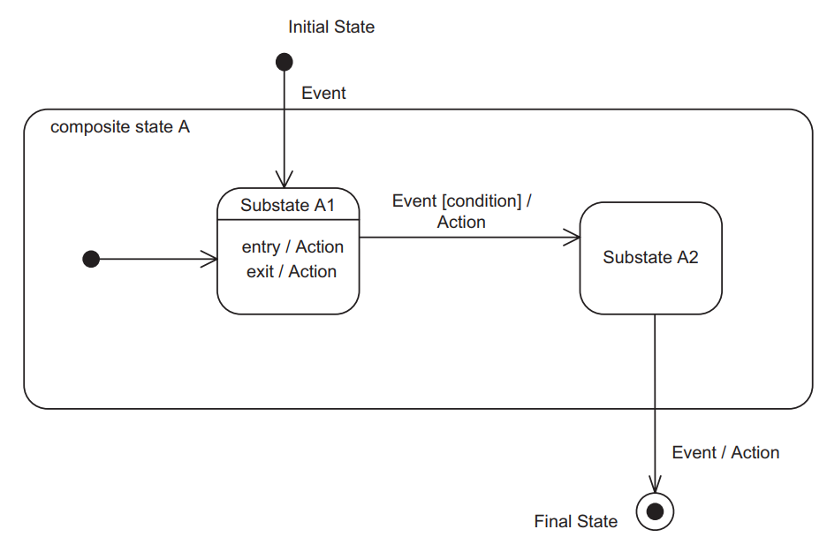
State Machine Diagrams
Notes:
The initial state of the statechart is depicted by an arc originating from a small black circle. Optionally, a final state may be depicted by a small black circle inside a larger white circle, sometimes referred to as a bull’s-eye. A statechart may be hierarchically decomposed such that a composite state is broken down into substates.
On the arc representing the state transition, the notation Event [condition]/ Action is used. The event causes the state transition. The optional Boolean condition must be true, when the event occurs, for the transition to take place. The optional action is performed as a result of the transition. Optionally, a state may have any of the following:
■ An entry action, performed when the state is entered
■ An exit action, performed on exit from the state

Slide 10
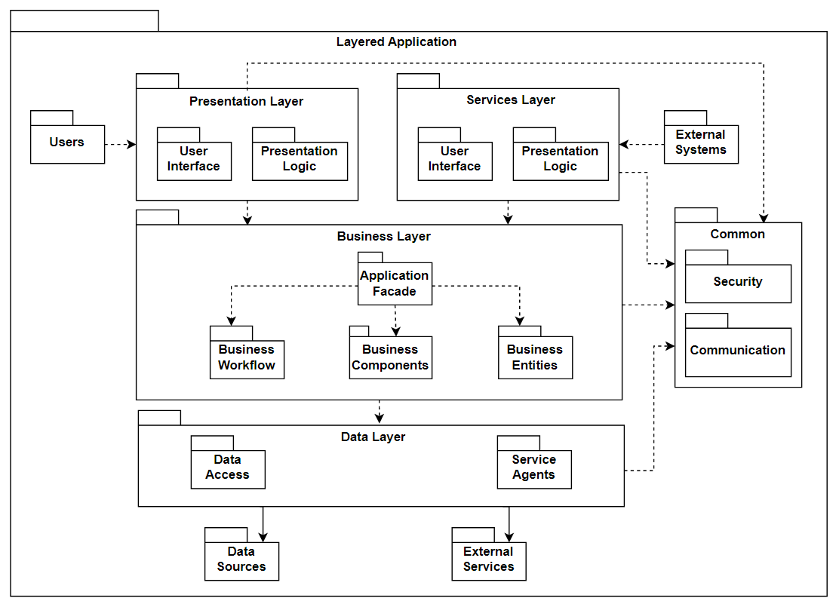
Package Diagrams
Notes:
In UML, a package is a grouping of model elements – for example, to represent a system or subsystem. A package is depicted by a folder icon, a large rectangle with a small rectangle attached on one corner. Packages may also be nested within other packages. Possible relationships between packages are dependency and generalization/specialization relationships. Packages may be used to contain classes, objects, or use cases

Slide 11
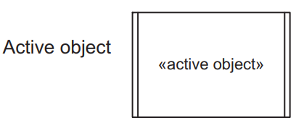
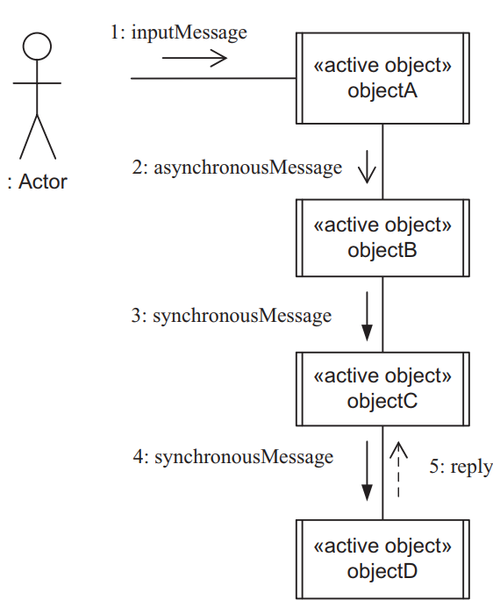
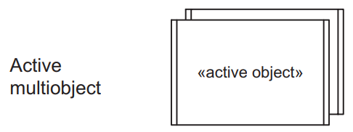
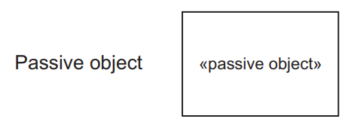
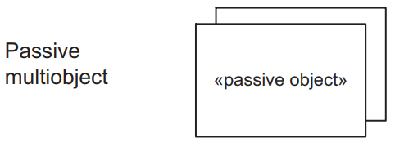
Concurrent Communication Diagrams
Notes:
In the UML notation, an active object can be used to depict a concurrent object, process, thread, or task, and is depicted by a rectangular box with two vertical parallel lines on the left- and right-hand sides.
An active object has its own thread of control and executes concurrently with other objects.
By contrast, a passive object has no thread of control. A passive object executes only when another object (active or passive) invokes one of its operations.

Slide 12
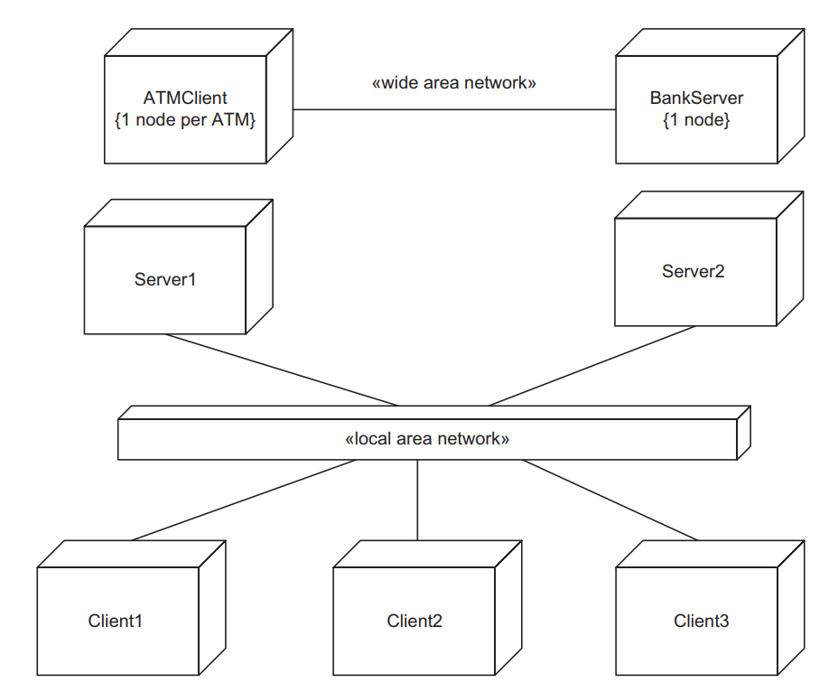
Deployment Diagrams
Notes:
A deployment diagram shows the physical configuration of the system in terms of physical nodes and physical connections between the nodes, such as network connections. A node is shown as a cube, and the connection is shown as a line joining the nodes. A deployment diagram is essentially a class diagram that focuses on the system’s nodes

Slide 13
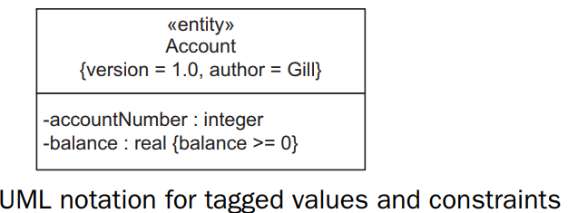
UML Extension Mechanisms 1/2
UML provides three mechanisms to allow the language to be extended (Booch, Rumbaugh, and Jacobson 2005; Rumbaugh, Booch, and Jacobson 2005)
A tagged value extends the properties of a UML building block, thereby adding new information. A tagged value is enclosed in braces in the form {tag = value}. Commas separate additional tagged values
A constraint specifies a condition that must be true. In UML, a constraint is an extension of the semantics of a UML element to allow the addition of new rules or modifications to existing rules

Slide 14
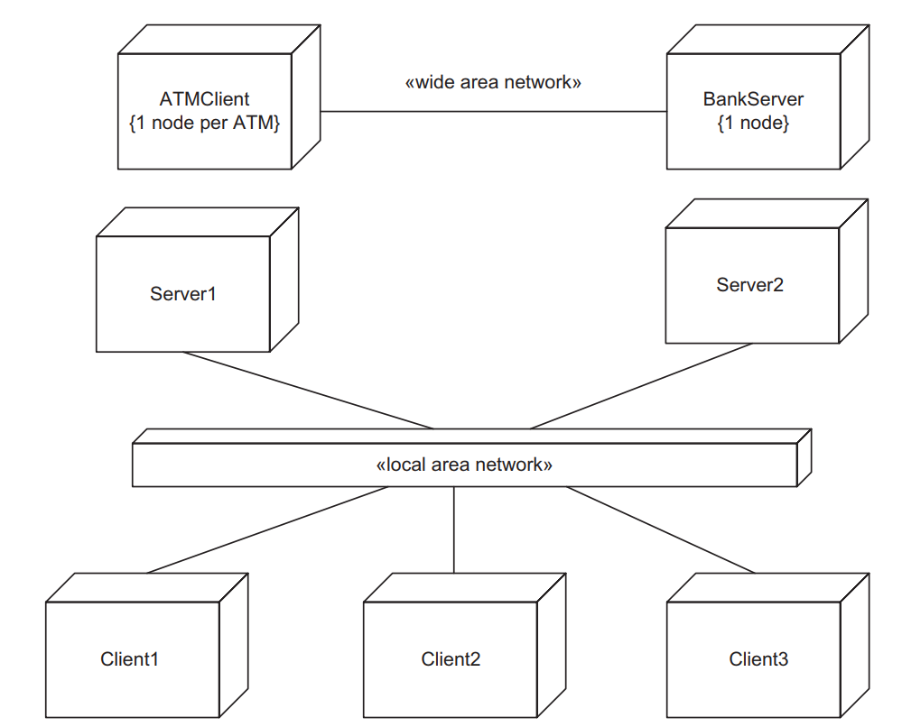
UML Extension Mechanisms 2/2
A stereotype defines a new building block that is derived from an existing UML modeling element but tailored to the modeler’s problem. Stereotypes are indicated by guillemets (« »)

Slide 15


